Slide 1



A320 FFS
Maintenance Technicians
Training Course
Prepared By: Mohamed Sakr
HYDRAULIC ACTUATOR
Thales Training & Simulation

Slide 2
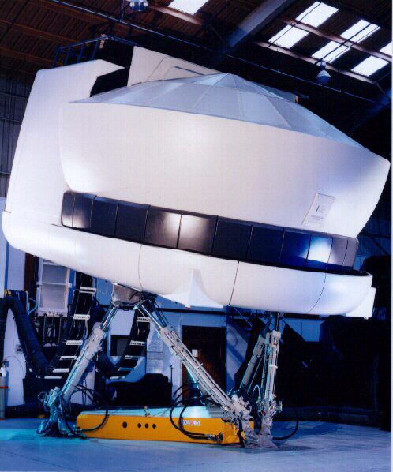
Motion System
Notes:
Motion Introduction
23-Apr-02
Instructor Notes
TTSL Prod Training Department

Slide 3
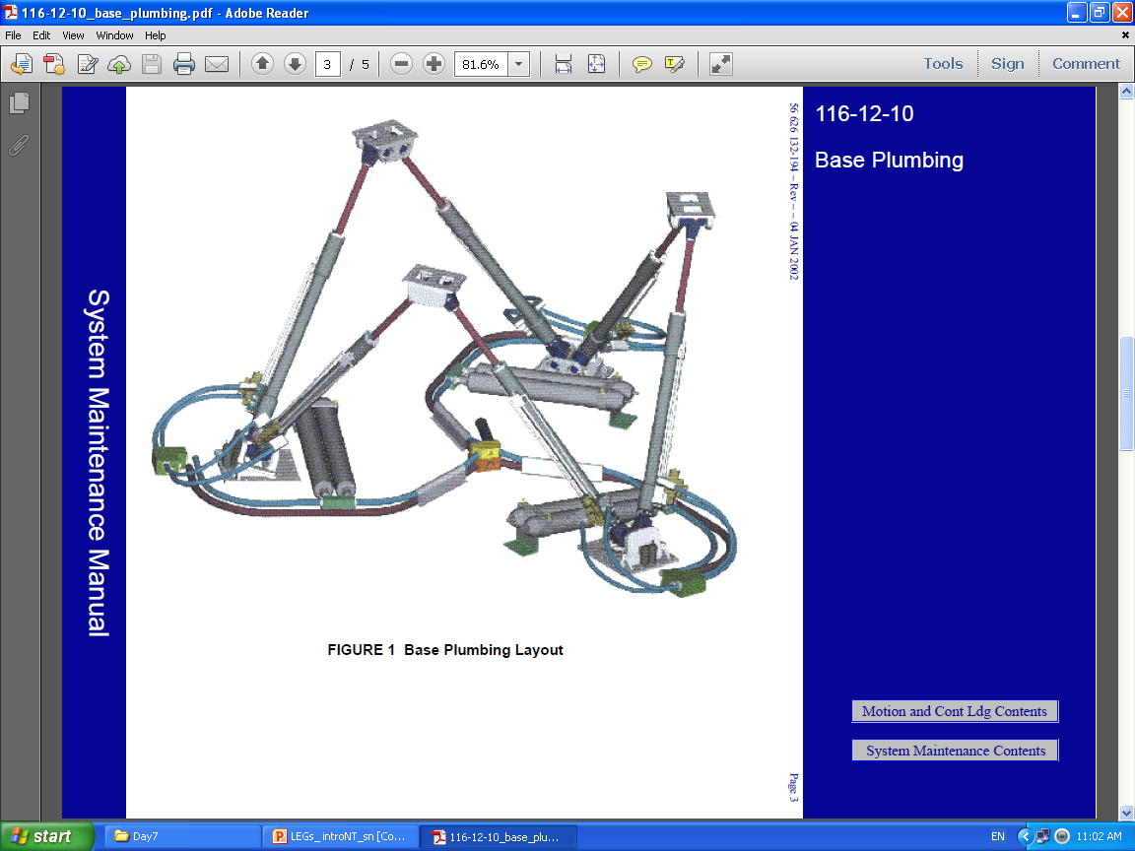

Slide 4
HYDRAULIC ACTUATOR
Hydraulic Actuator
Pressure Trans.
Position Transducer
Servo Valve
Pressure Trans.
Notes:
Motion Introduction
23-Apr-02
Instructor Notes
TTSL Prod Training Department

Slide 5
Motion System - Servo Loop
SIMULATOR
PLATFORM
POSITION
TRANSDUCER
ANALOGUE SIGNALS
MOTION
Repadis
FEEDBACK
PRESSURE
TRANSDUCER
FEEDBACK
SERVO
VALVE
SERVO DRIVE
HPU
PRESSURE
TRANSDUCER
Notes:
Motion Introduction
23-Apr-02
Instructor Notes
TTSL Prod Training Department

Slide 6
Motion System - Servo Loop
Platform Attitude
Demand from Host
ANALOGUE SIGNALS
MOTION
Repadis
POSITION
TRANSDUCER
FEEDBACK
FEEDBACK
PRESSURE
TRANSDUCERS
SERVO
VALVE
SERVO DRIVE
Notes:
Motion Introduction
23-Apr-02
Instructor Notes
TTSL Prod Training Department

Slide 7
Motion System - Servo Loop
Platform Attitude
Demand from Host
ELECTRONIC CONTROL
CAMIO 0
(MIO DSP)
POSITION
TRANSDUCER
PRESSURE
TRANSDUCERS
SERVO
VALVE
MOTION
Repadis
Notes:
Motion Introduction
23-Apr-02
Instructor Notes
TTSL Prod Training Department

Slide 8
Motion System - Servo Loop
Platform Attitude
Demand from Host
CAMIO 0
(MIO DSP)
Actuator
# 1
PMC
HSSL
Link
Actuator
# 2
Actuator
# 3
Actuator
# 4
MOTION
Repadis
Actuator
# 5
Actuator
# 6
Notes:
Motion Introduction
23-Apr-02
Instructor Notes
TTSL Prod Training Department

Slide 9
Motion System - Interlocks
Platform Attitude
Demand from Host
CAMIO 0
(MIO DSP)
PMC
HSSL
Link
Actuators
MIO I/O (5)
MIO I/O (5)
MIO I/O (5)
MIO I/O (5)
MIO I/O (5)
Interlocks
MOTION
Repadis
RAM (3)
RAM (3)
RAM S (3)
Relays
Control and
Safety
Circuits
MAM
Drawbridge
Field Bus
Notes:
Motion Introduction
23-Apr-02
Instructor Notes
TTSL Prod Training Department

Slide 10
MOS Repadis Circuit Boards
CAMIO (MIO DSP)
  Calculates actuator extensions
  Applies drive to Servo valve
  Monitors feedback from transducers
  Communicates on HSSL
MIO IO
  Monitors safety interlocks
  Controls and monitors HPU status
  Communicates on Field Bus (FIP)
Notes:
Motion Introduction
23-Apr-02
Instructor Notes
TTSL Prod Training Department

Slide 11
MOS Repadis Circuit Boards
RAM S (Relay Adaptation Module Safety)
  Drawbridge raise lower relays
  Safety relays
  Latency relays
MAM (Miscellaneous Adaptation Module)
  Drawbridge safety monitor
Notes:
Motion Introduction
23-Apr-02
Instructor Notes
TTSL Prod Training Department

Slide 12
MOTION ELECTRONICS
J6
J5
J4
J3
J2
J1
S
L
O
T
C
A
M
I
O
0
S
L
O
T
S
P
A
R
E
S
P
A
R
E
S
L
O
T
S
L
O
T
S
P
A
R
E
S
P
A
R
E
S
L
O
T
S
L
O
T
S
P
A
R
E
J17
J16
J15
J14
J13
J12
J11
J10
J9
J8
J7
M
A
M
S
L
O
T
S
L
O
T
R
A
M
S
2
S
L
O
T
R
A
M
S
1
R
A
M
S
3
S
L
O
T
S
L
O
T
S
P
A
R
E
S
P
A
R
E
S
L
O
T
M
I
O
I
O
5
S
L
O
T
S
L
O
T
M
I
O
I
O
4
S
L
O
T
M
I
O
I
O
3
S
L
O
T
M
I
O
I
O
2
S
L
O
T
M
I
O
I
O
1
MOS Crate MCc
Notes:
Motion Introduction
23-Apr-02
Instructor Notes
TTSL Prod Training Department

Slide 13
Motion Cabinet Layout (MC)
Motion Crate
(MCc)
Notes:
Motion Introduction
23-Apr-02
Instructor Notes
TTSL Prod Training Department

Slide 14


References : THALES STD simulator Manufacture manual .
?
Please Feel free to Ask
Practical

